Slide 1
Maximizing Kickstarter Campaign Success
An Analysis by Rachel Downs and Muhammad Ghauri

Slide 2

$11.4M
(product): a global crowdfunding platform where “creators” can run “campaigns” for people to fund and “back” their project.
of wasted funding in 2016

Slide 3
Content
Business Proposition
^
Objectives | Methodology | Insight | Modeling | Implication

Slide 4
Our Objective
what are you tryna do?

Slide 5
Our Goals
Understand the marketplace for Kickstarter
Give insight into what attributes successful campaigns have in common
Build a model to predict which campaigns will succeed (and fail)
Identify a business opportunity Kickstarter may be sitting on

Slide 6

this analysis is made possible by data mining

Slide 7
Data Methodology
lemme show you how it’s done

Slide 8
Kickstarter Campaigns
*as of 2/1/17
20,632
Existing Data:
Campaign name and blurb (description)
Funding goal, number of backers and amount pledged
State: successful, failed, cancelled, or live
Time of creation, launch and deadline
Country and currency
Category
Extracted Data:
Length of name and blurb including and excluding “stop words”
Day of week and hour of day for creation, launch and deadline
Number of days between creation and launch
Number of days between launch and deadline

Slide 9
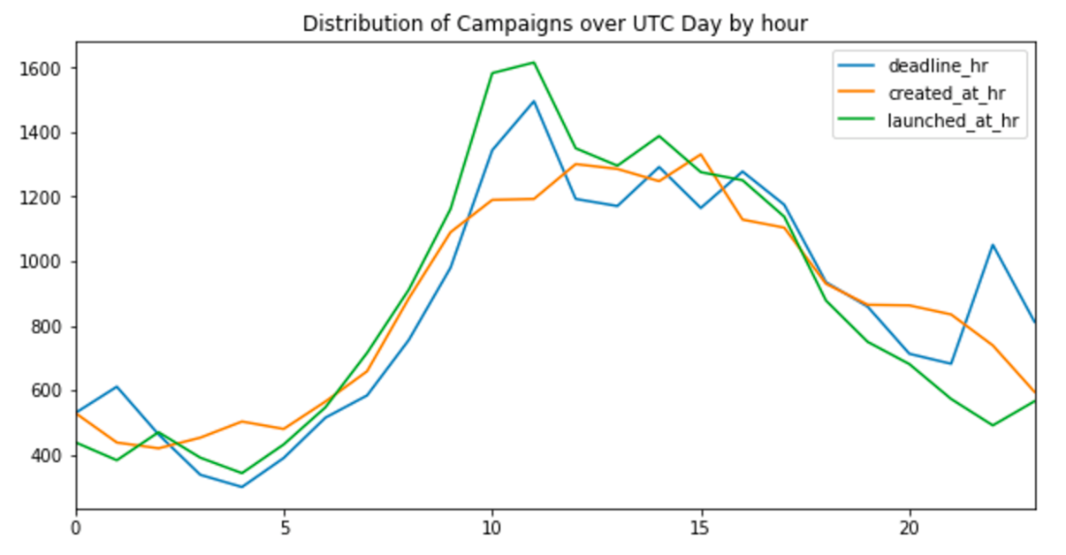
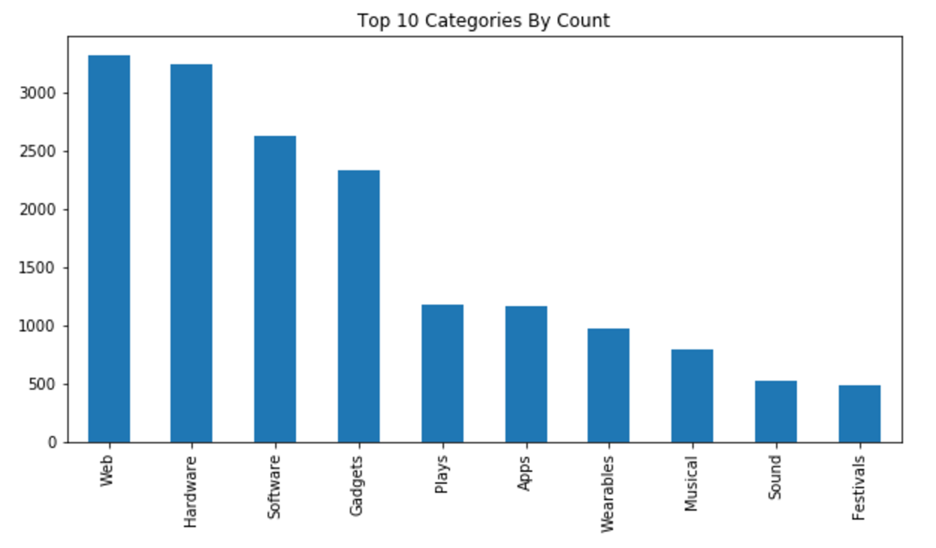
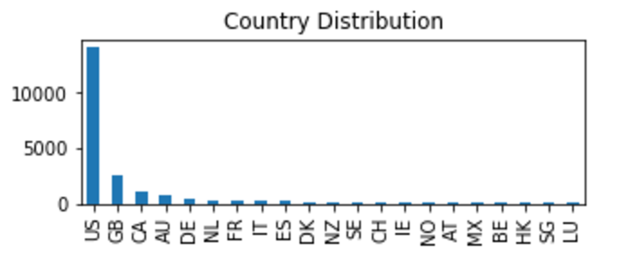
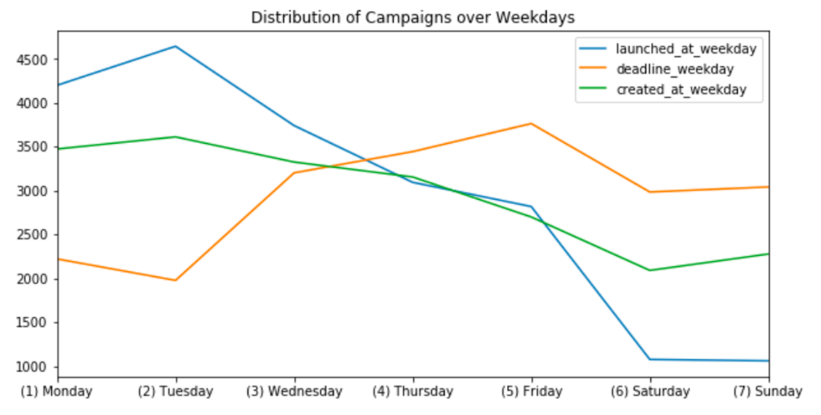
Understanding the Marketplace
Kickstarter is predominantly domestic
Campaign timing is more systematic than you would think
Kickstarter campaigns have a strong technology and entertainment focus

Slide 10
Insights for success
tell me somethin’ i don’t know

Slide 11
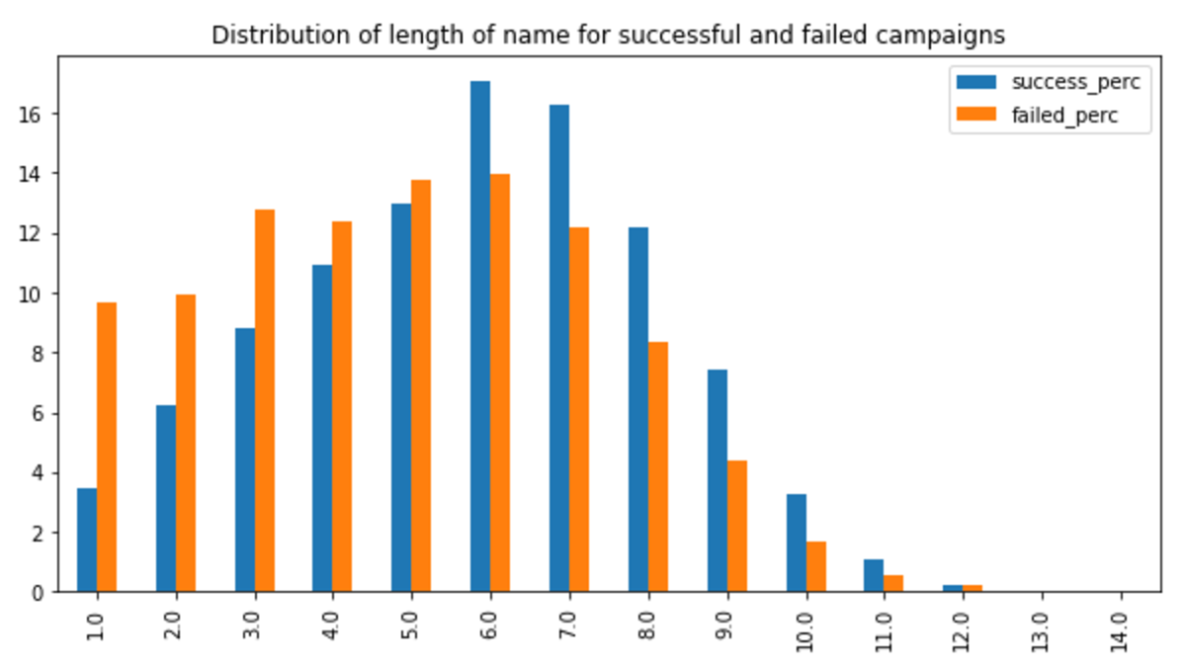
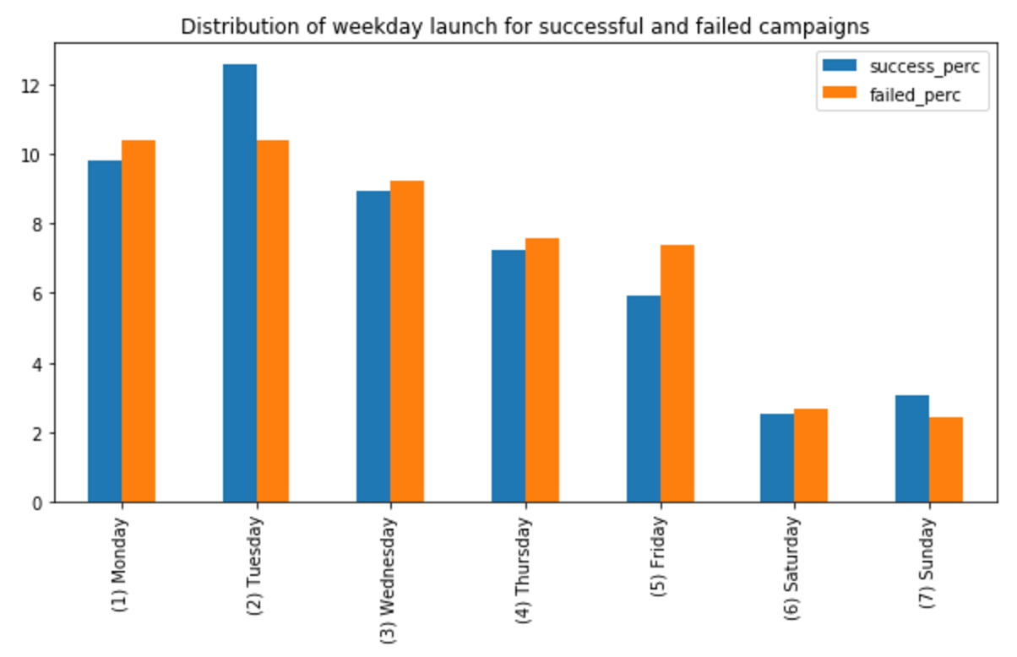
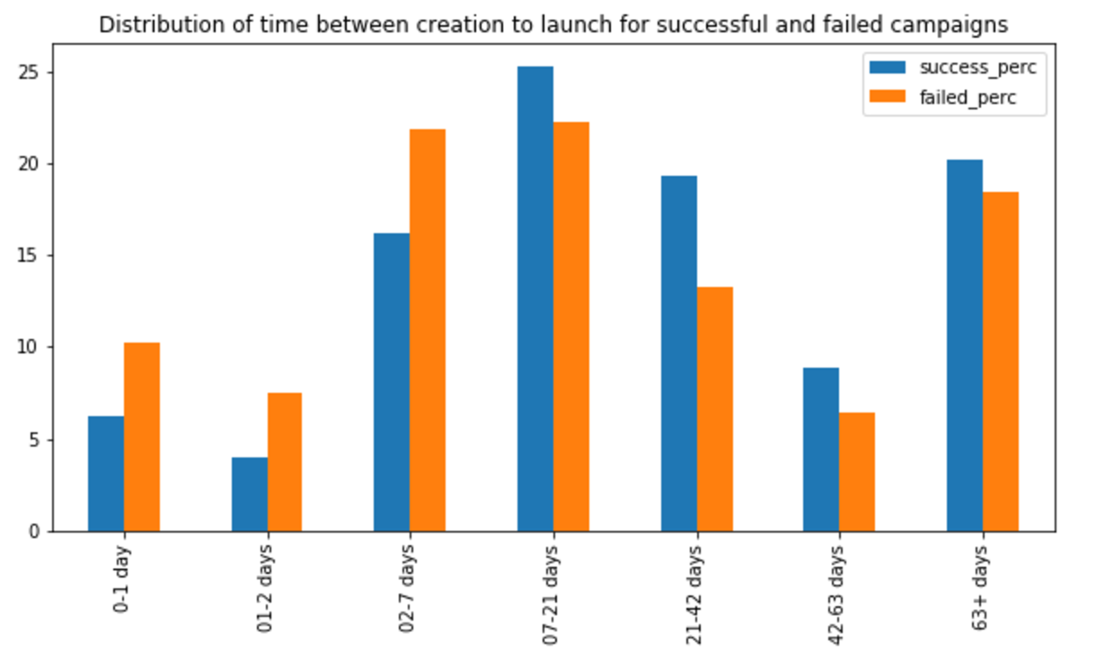
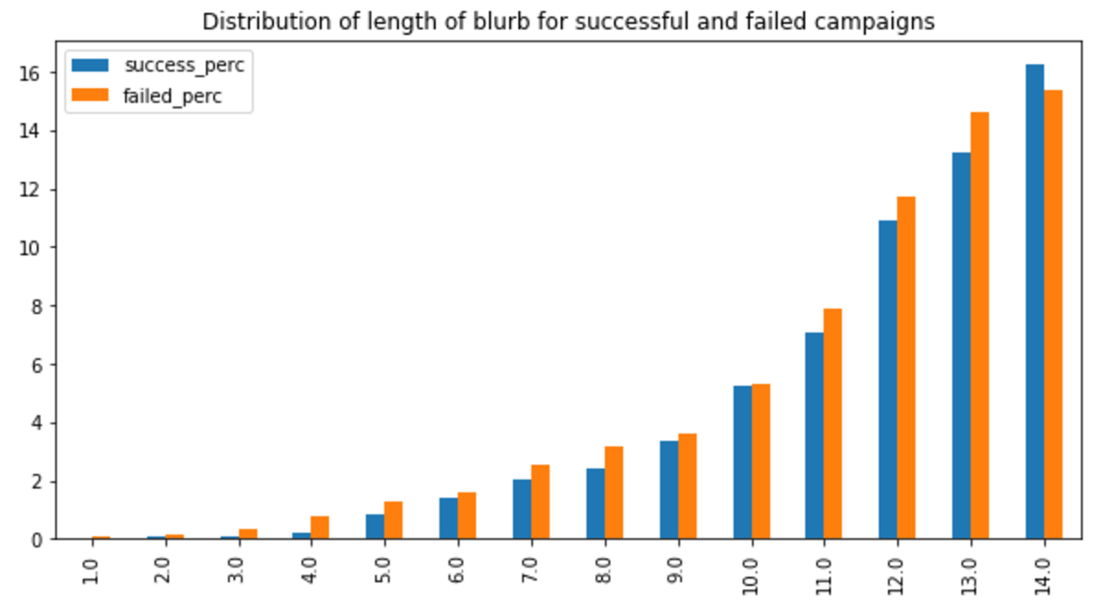
Campaigns with longer descriptions and names are more likely to be successful
Successful campaigns invest more time in creating the campaign
Tuesdays and Sundays are the best days to launch a campaign

Slide 12
Getting to the Good Stuff
insights continued
Setting the right goal is as important as you’d think.
Staff picks have significant impact on campaign success.

Slide 13
Building a Model
making the machine

Slide 14
Tossing Out Bad Data
State
Spotlight
Backers Count
USD Pledged
Pledged
Staff Pick
Launch to State Change Days

Slide 15
Picking the best Model
Model Name | Classification Accuracy | Precision (Weighted) | Recall (Weighted)
Bagging | 67.8249 % | 0.662 | 0.678
Naive Bayes | 69.715 % | 0.773 | 0.697
K Nearest Neighbors | 65.804 % | 0.619 | 0.658
Random Forest | 65.8186 % | 0.598 | 0.658
J48 | 71.9541 % | 0.708 | 0.720
Contenders:
Bagging
Naïve Bayes
K Nearest Neighbors
Random Forest
J48 (Classification Trees)

Slide 17
The Business Prop.
just hear me out

Slide 18
This is Where We Make Money
134
$5,750
10%
$77,050

Slide 19
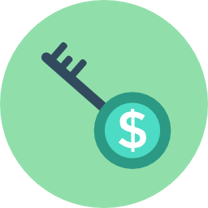
What’s the Key?
Staff Picks

Slide 20
The Implications
it can always be sunny at Kickstarter

Slide 21


If You Remember Anything, Remember This
To the campaign creators:
Make your description longer
Spend more time creating your campaign
Keep your goals realistic
To Kickstarter:
Try to make more campaigns successful by using Staff Picks

Slide 22
Thank You

